Slide 1
AUGUST 10, 2022

Slide 2
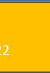
General Changes
All table header make center
Color management : Approve (Green), Activate (#26a69a), Deactivated (Orange), Disapprove(red), Pending (same with the color below)
Remove the “x” in all modal pop up
On the date range picker must not be ahead on the current date
AUGTUST 11, 2022
Table header all bold text . Table data make it unbold, For all the data with heads and weight make it text-justify font-size maximize summary
For all the button with the dropdown selection replace a text to “Filter”
And add a search datatables template

Slide 3
Dashboard page

Slide 4
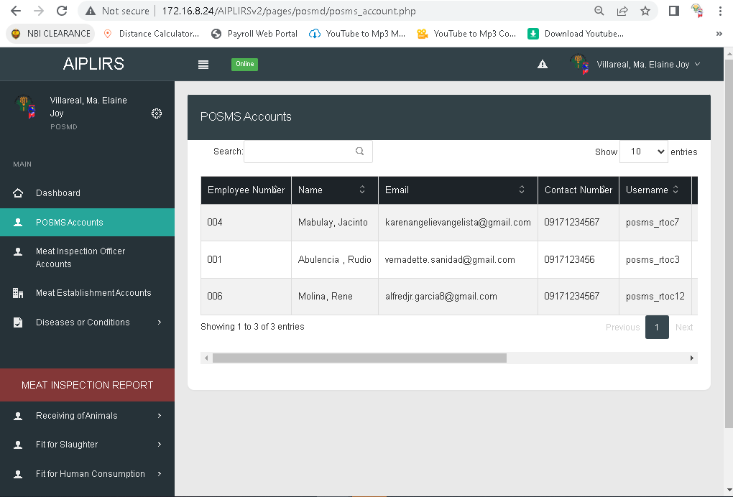
Limit to mobile number upon registration
POSMS account

Slide 5
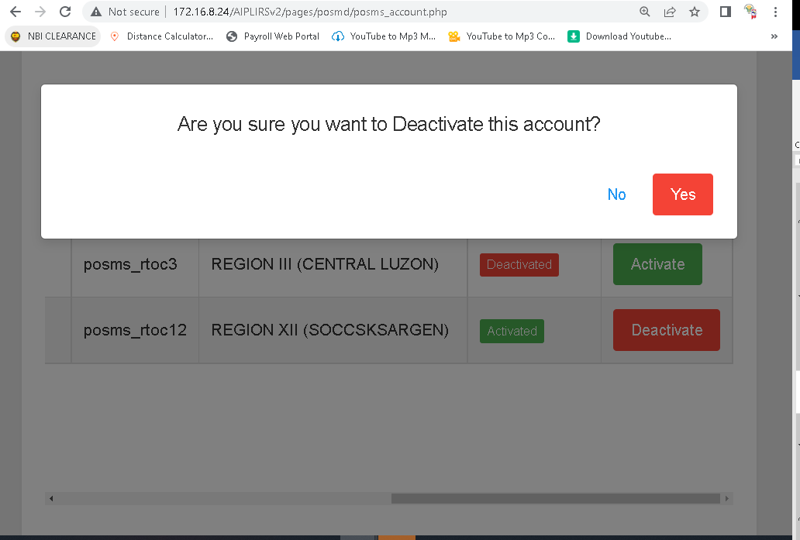
letter D make it small
First “Yes” “No” : green and red make it center

Slide 6
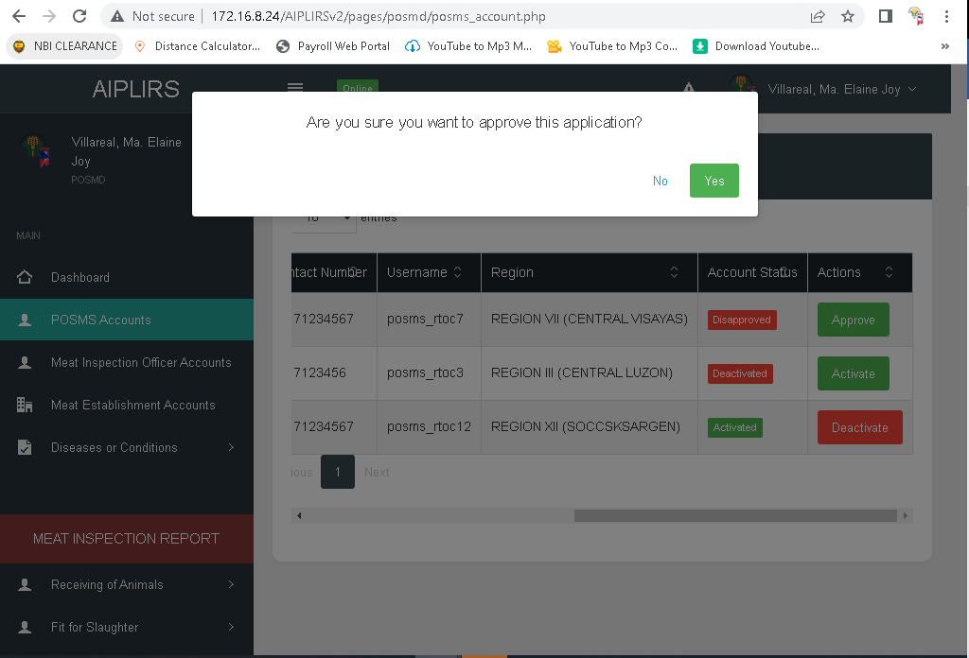
First “Yes” “No” : green and red make it center

Slide 7
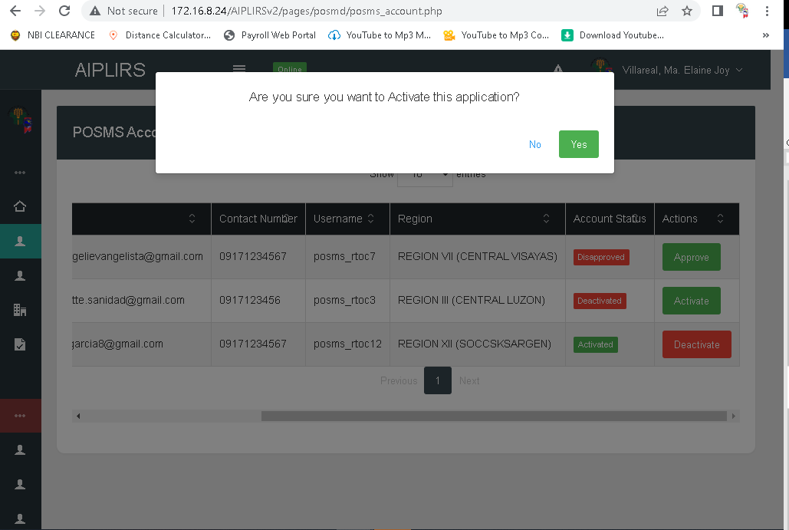
Change the message to application to account letter A make it small
First “Yes” “No” : green and red make it center

Slide 8
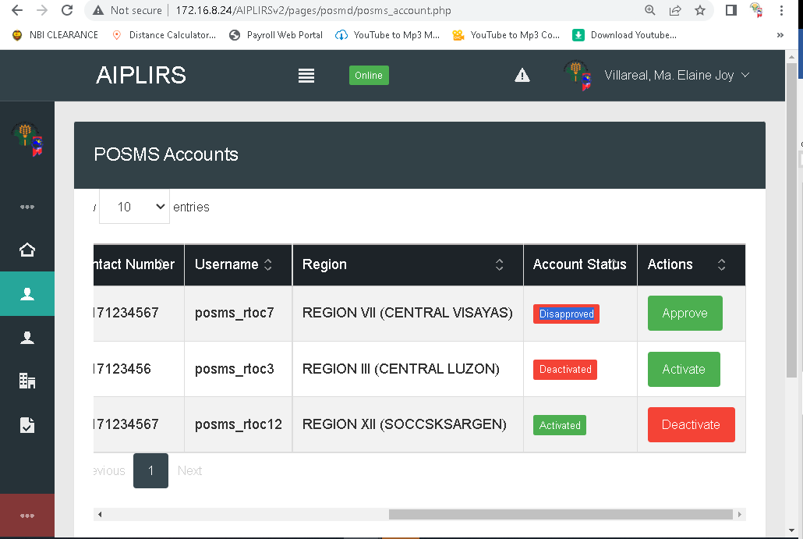
Change the color of disapprove and approve

Slide 9
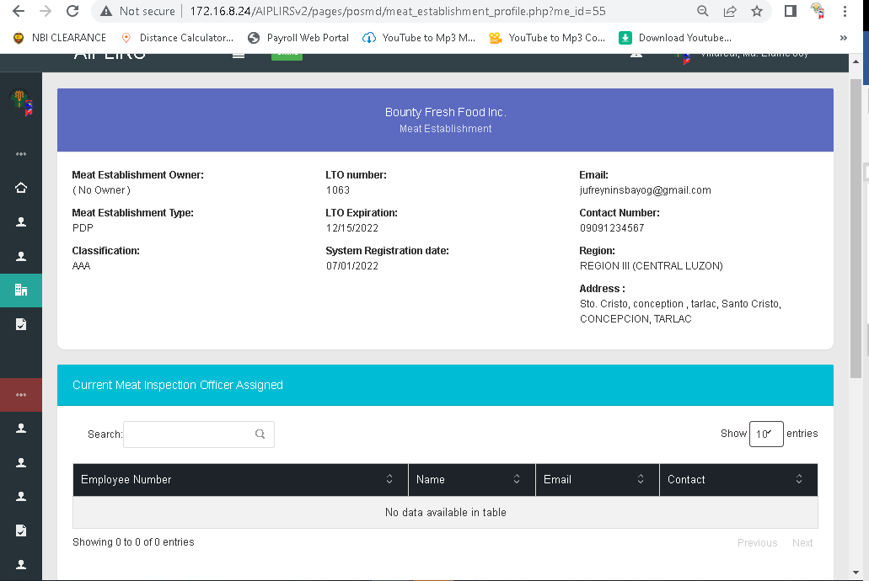
Capitalize “Number”, “Date”

Slide 10
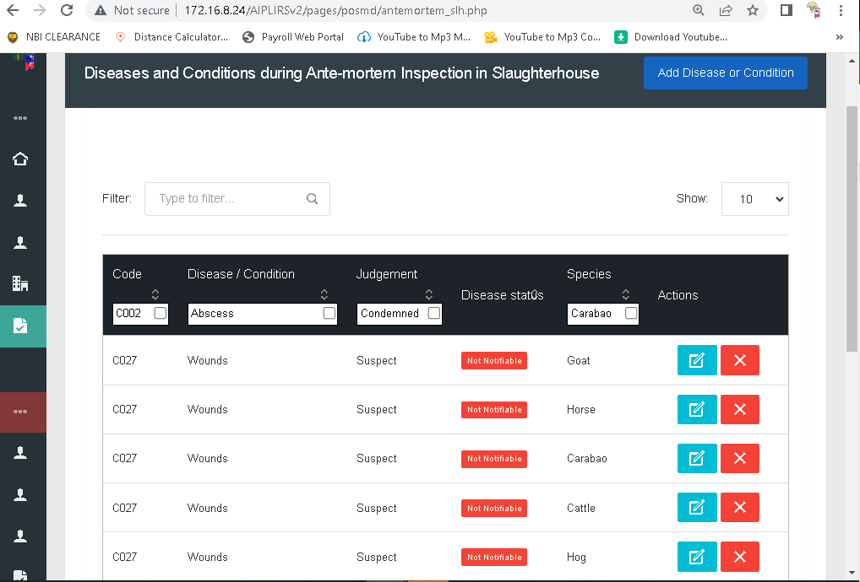
Notifiable : is to red bold text no background
Not notifiable: is to green bold text no background in all pages of diseases

Slide 11
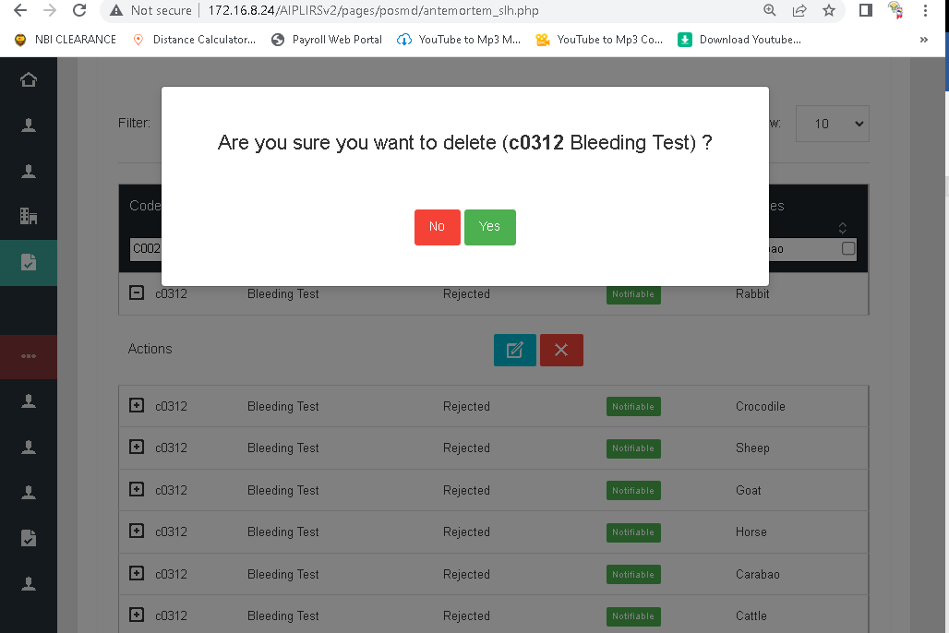
Remove parethesis
And remove unbold text
Remove spacing
First “Yes”

Slide 12
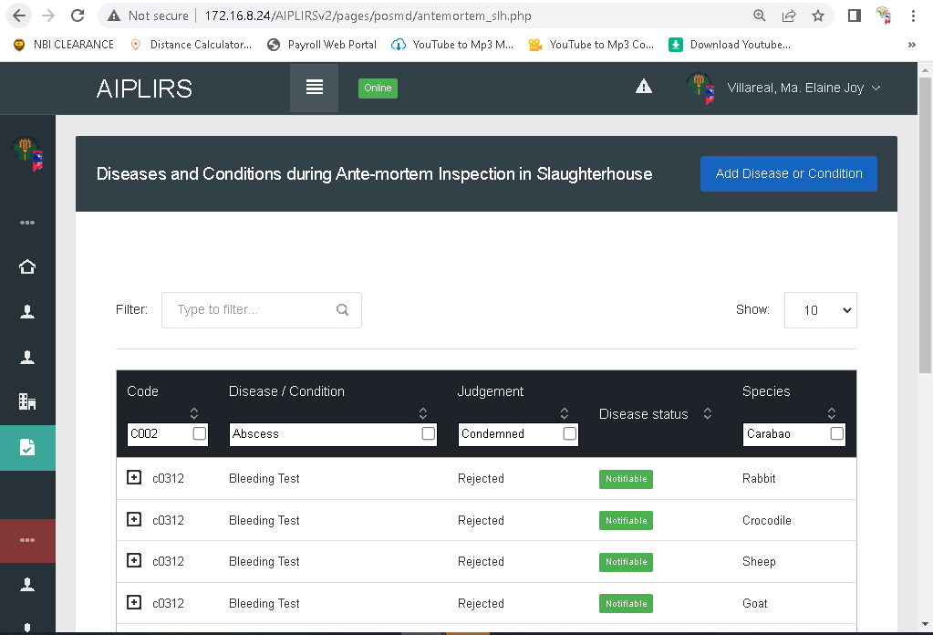
Move down button align right on the bottom of header

Slide 13
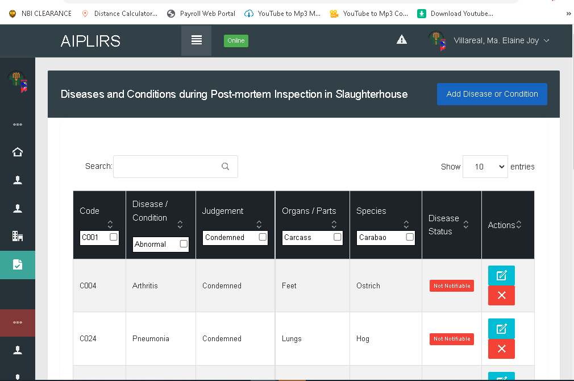
Move down button align right on the bottom of header in all pages of diseases
Change icon into word
Edit . Delete

Slide 14
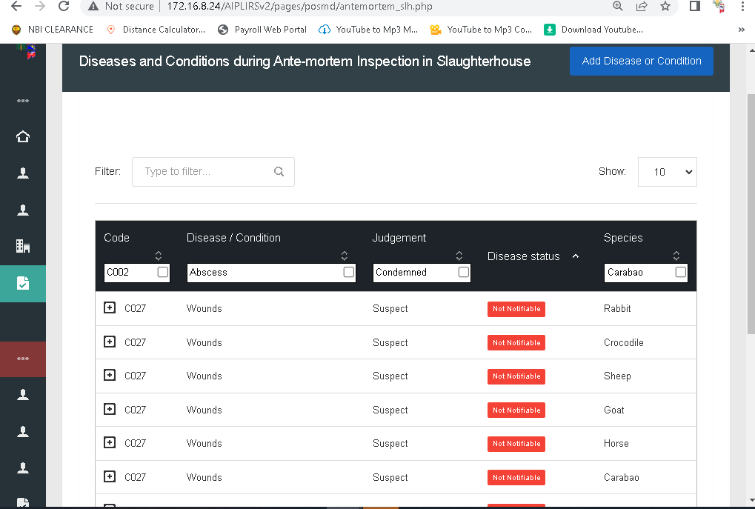
For the order of the table
Code, Disease or condition, judgement, species, Disease status, Actions
Instead of filter change to search in all pages of diseases
Sticky table header in all pages of diseases
Add a dropdown for filtering in all pages of diseases
Remove plus button to make visible of actions

Slide 15
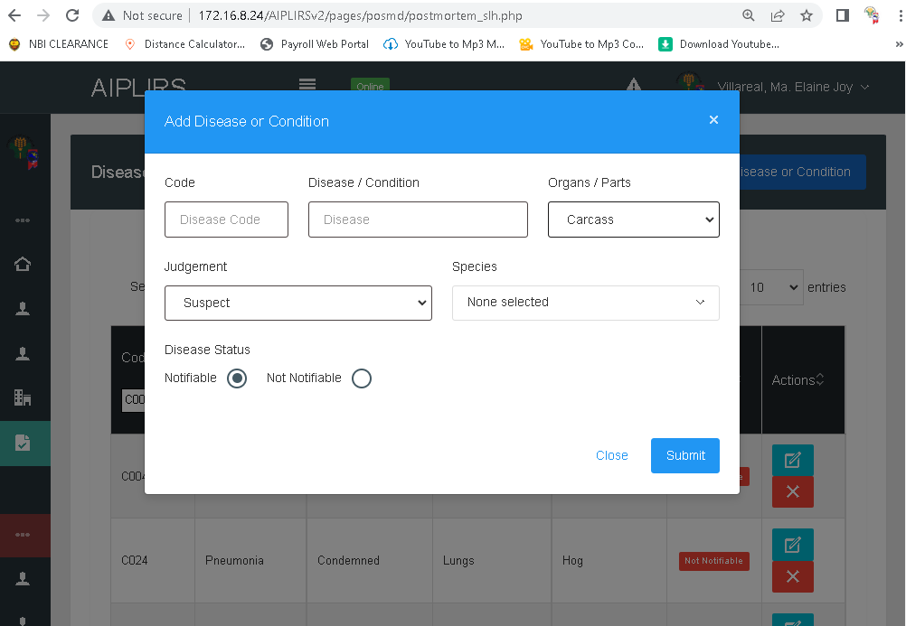
Multiple Selection Postmortem

Slide 16
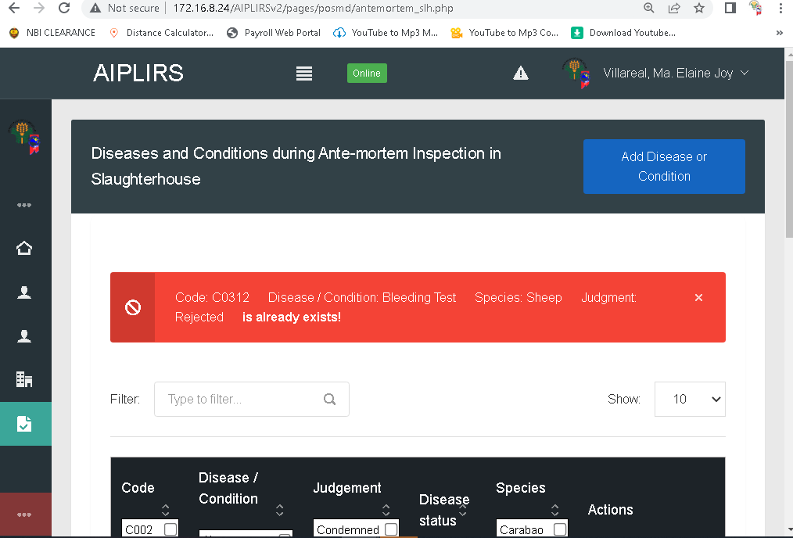
Change to “already exist”
Make white background red border
Color red, for the icon change to exclamation point
Specify each Species have duplicated data
Spelling of judgement
Capitalize Status in all disease pages

Slide 17
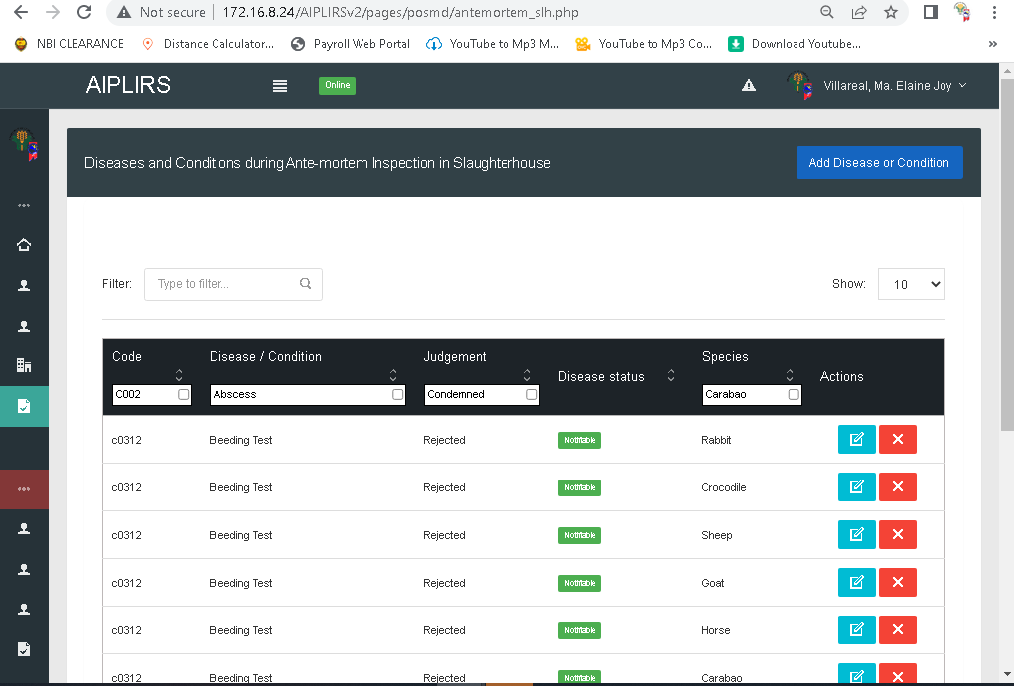
Row alternate color
Border table
Change positioning to species after disease status
Change label to select

Slide 18
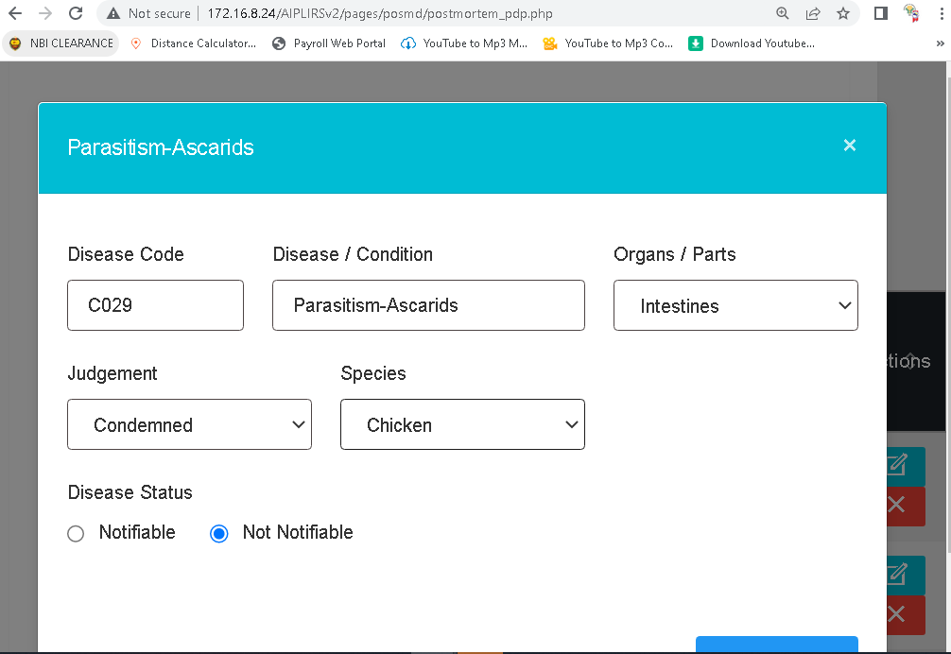
Update with multiple species insertion of data
Add a pigion and remove ostrich

Slide 19
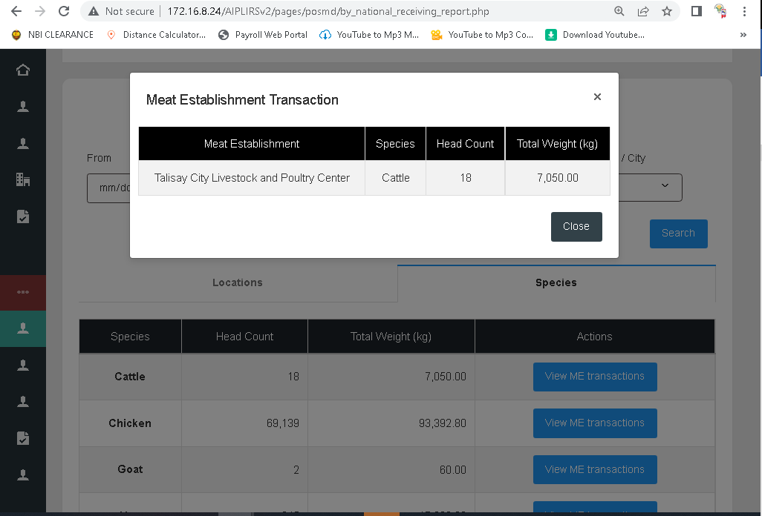
Another column “region” :

Slide 20
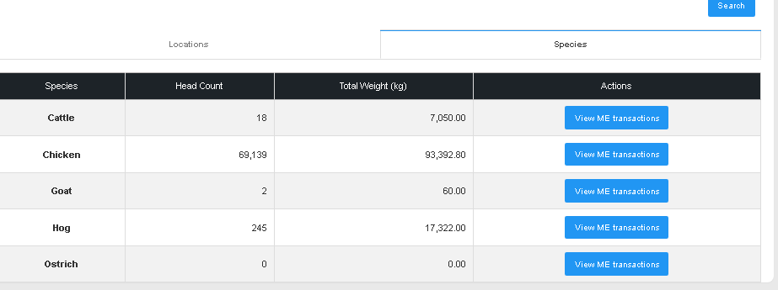
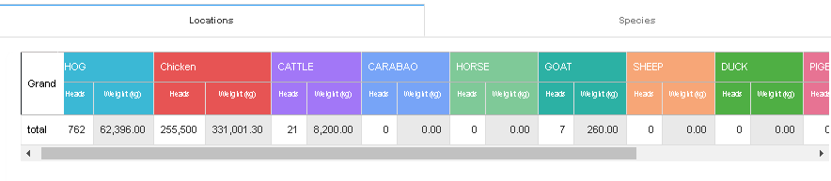
Result not equal change syntax

Slide 21
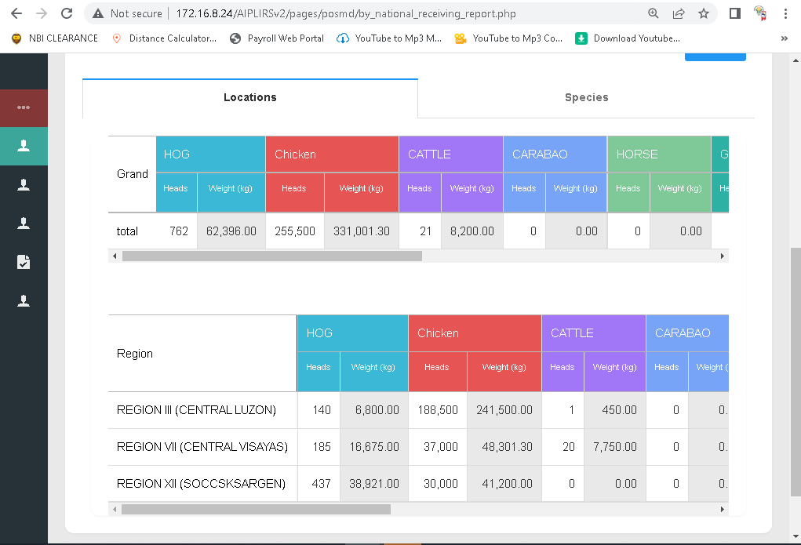
Filtering of National data receiving of animals
Change to Grand to grand total
Chicken make it all caps
Change to National Data
Chicken make it all caps

Slide 22
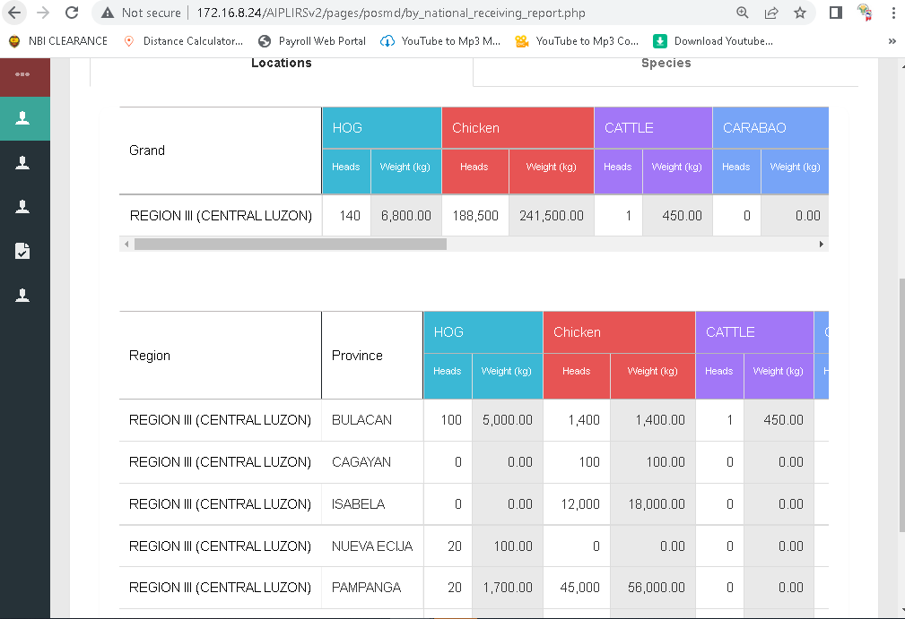
Filtering of Regional data receiving of animals
Chicken make it all caps
Change to Grand to grand total
Chicken make it all caps

Slide 23
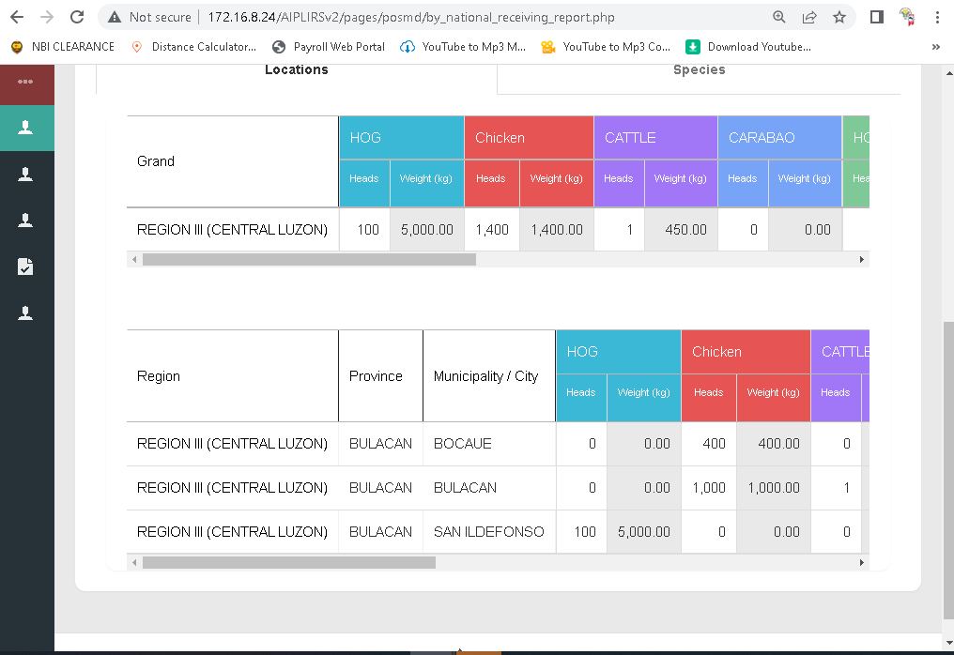
Filtering of Provincial data receiving of animals
Chicken make it all caps
Add a colum for province base in filter
Change to Grand to grand total
Chicken make it all caps

Slide 24
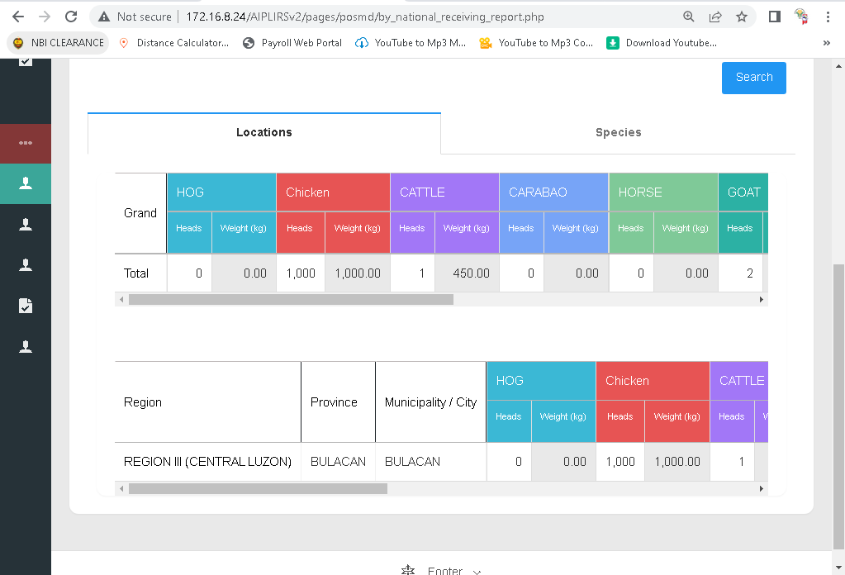
Filtering of Municipality data receiving of animals
Remove this table
Add a column for the total merge by row

Slide 25
PENDING OBSERVATION
July 29 – 30 2022

Slide 26
AUGUST 11, 2022

Slide 27
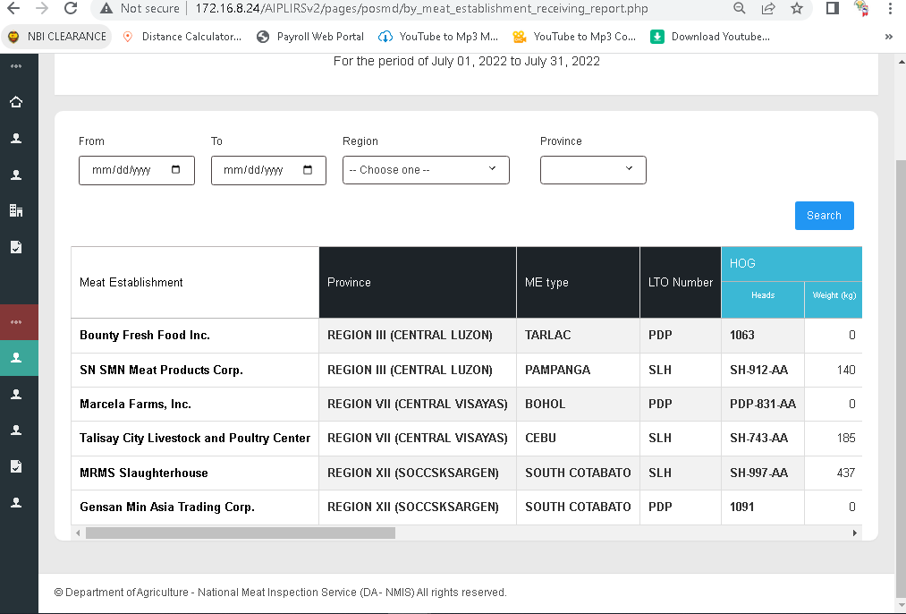
Additional Dropdown for city filtering
Align with the filter fields and rename search to filter
Bold text for the table header Meat Establishment
Missing Column for region
Add a live search and for the place holder “Meat Establishment”
Change to “Type”

Slide 28
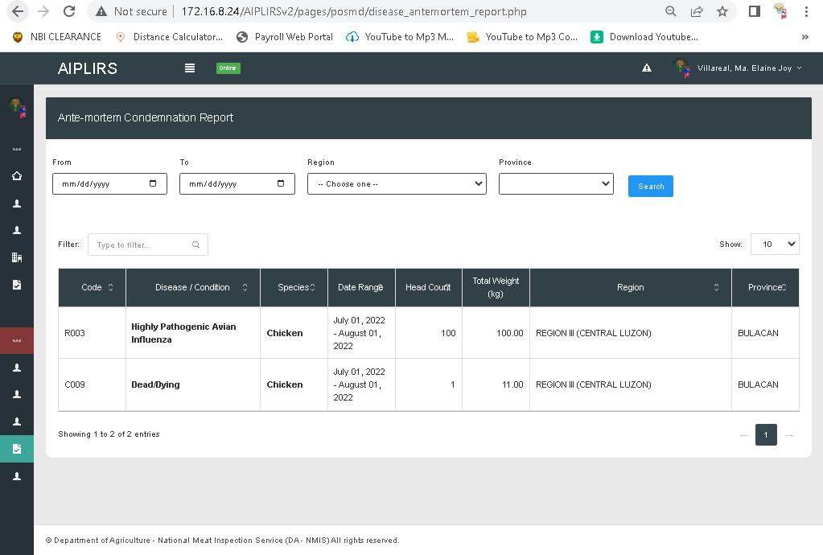
Change label to “search” input
Add dropdown for the municipality
Total head count
Change to Filter
Add a multiple filter for the disease / condition & species

Slide 29
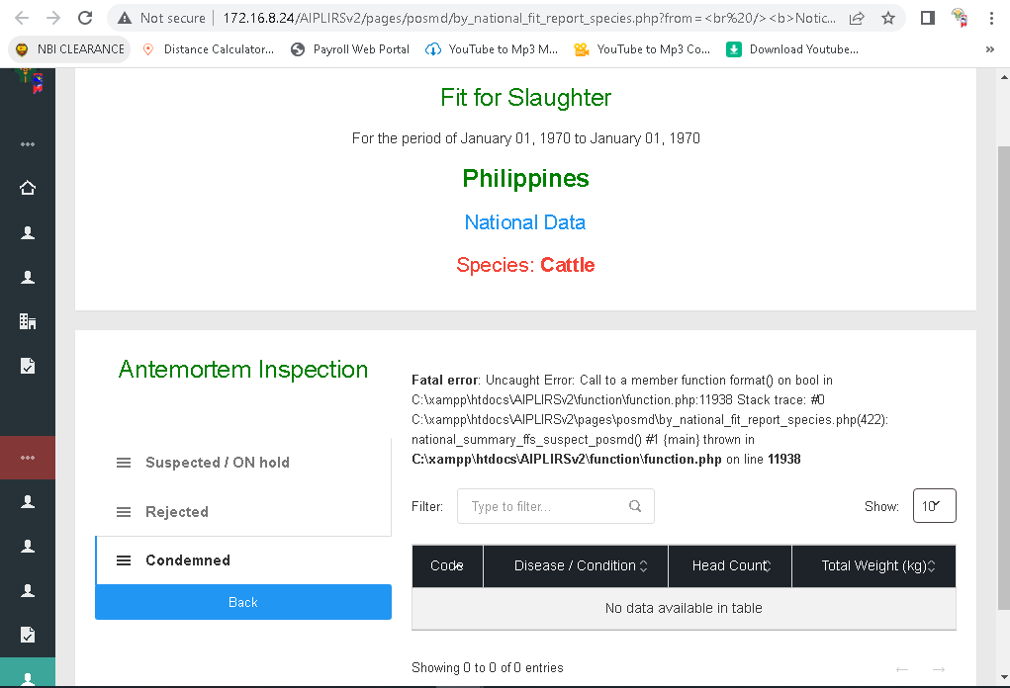

Slide 30
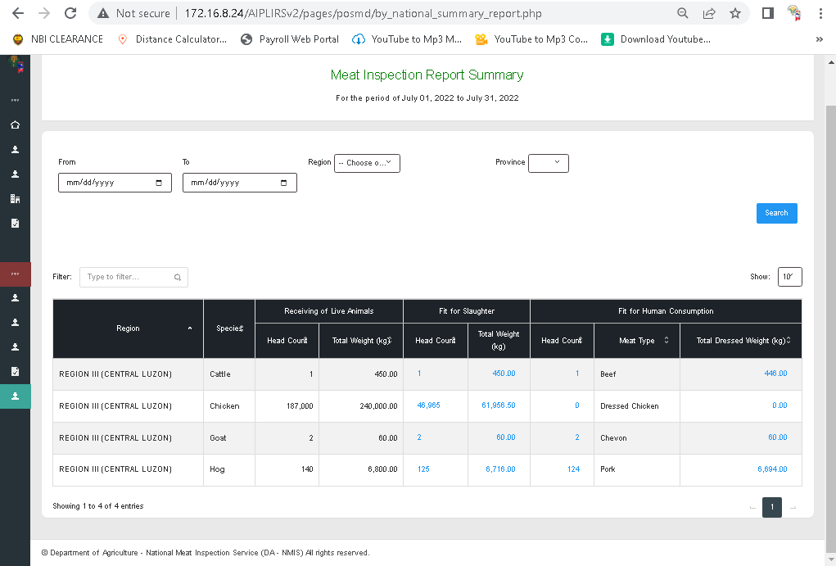
Result Check from the RECEIVING TO FIT FOR HUMAN CONSUMPTION
Add dropdown for the municipality
Chagne to filter label
Chamge to “receiving of animals
Change to total head count
Sorting unresponsive

Slide 31
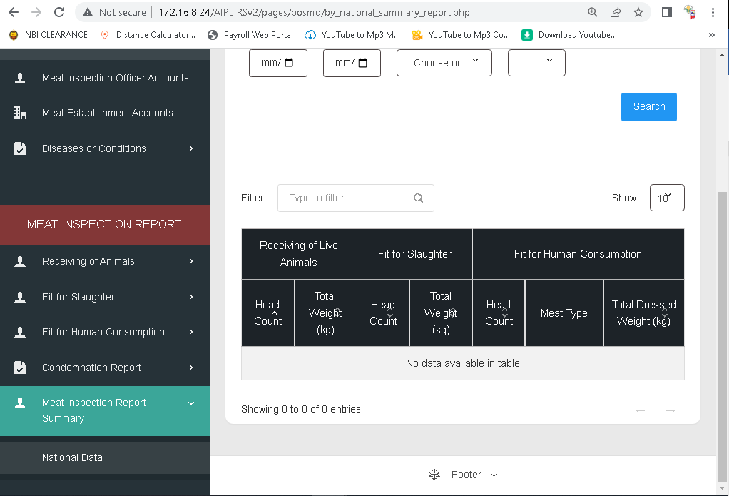
Add a dropdown and PAGE for the MEAT ESTABLISHMENT INSPECTION REPORT

